Slide 1
Time Series Forecasting of GIVA Customers
File created on: 12/12/2022 2:26:12 PM

Slide 2
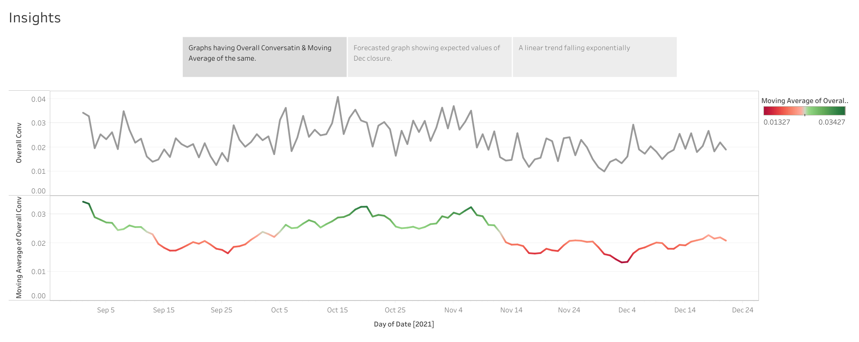

Slide 3
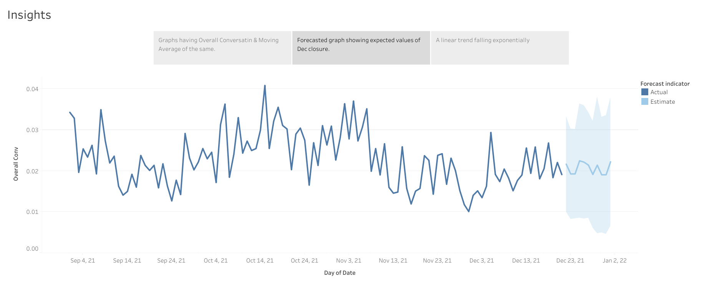

Slide 4
